Slide 1
Pakistan

Slide 2
About Pakistan
Pakistan Officially Known As The Islamic Republic Of Pakistan.
Is A Country Located In South Asia.
23 March 1940 Is The Resolution Day Of Pakistan.
14 August 1947 Is The Independent Day Of Pakistan.
Quaid E Azam Mohammad Ali Jinnah Is The First Founder Of Pakistan.
Urdu Is The National Language Of Pakistan.
Pakistan Is A Fertile Country.

Slide 3
Flag Of Pakistan

Slide 4
About Pakistan’s Flag
Colour Of Flag Is Green And White.
Green: Representing Islam And Prosperity.
White Cresent: Representing Progress And Knowledge.
Five Pointed Star: Representing The Five Principles Of Pakistan.
Principles Of Pakistan: Unity, Faith, Discipline, Justice And Equality.

Slide 5
Provinces Of Pakistan
Sindh.
Punjab.
Balochistan.
Kpk.
Gilgit Baltistan.

Slide 6
Places to visit
Lahore: Mughal Architecture, Food And Culture.
Karachi: Beaches, Food And Night Life.
Islamabad: Faisal Mosque And Margalla Hills.
Mohenjo-daro: Ancient Indus Valley Civilization Ruins.
Northern Areas: Natural Beauty, Trekking, Lakes, Snowfall, Mountains And Adventures .

Slide 7
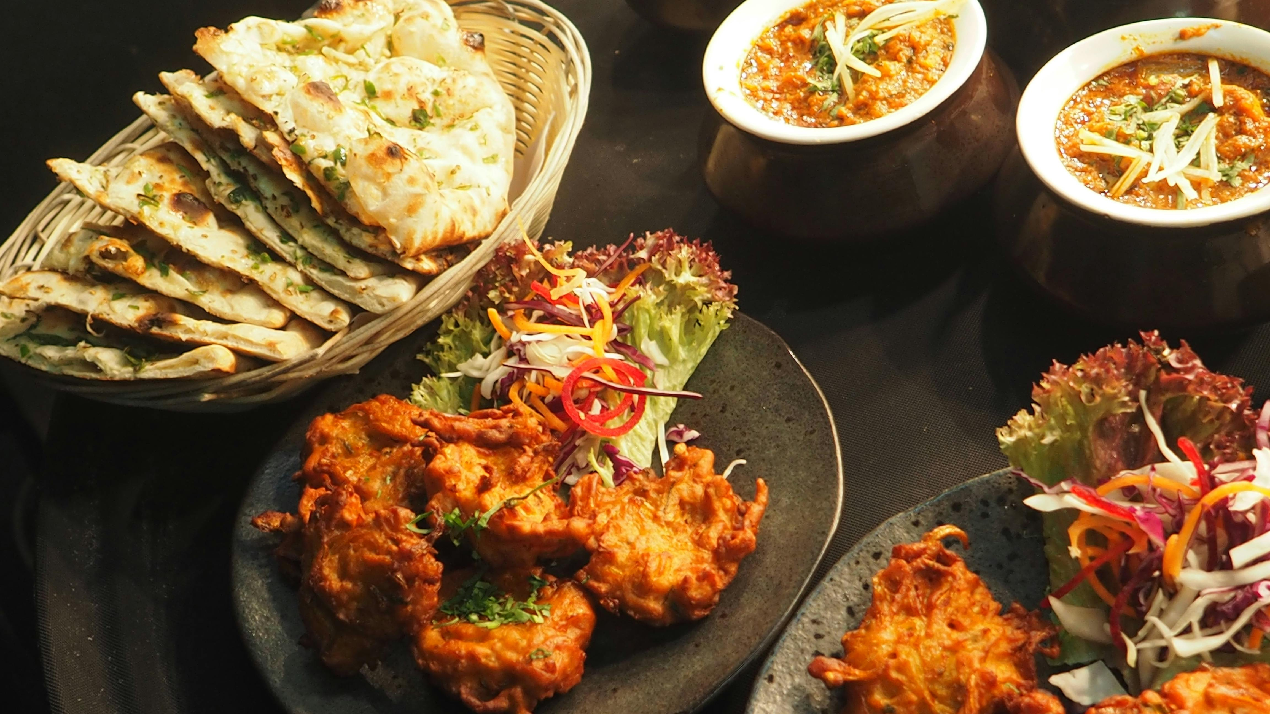
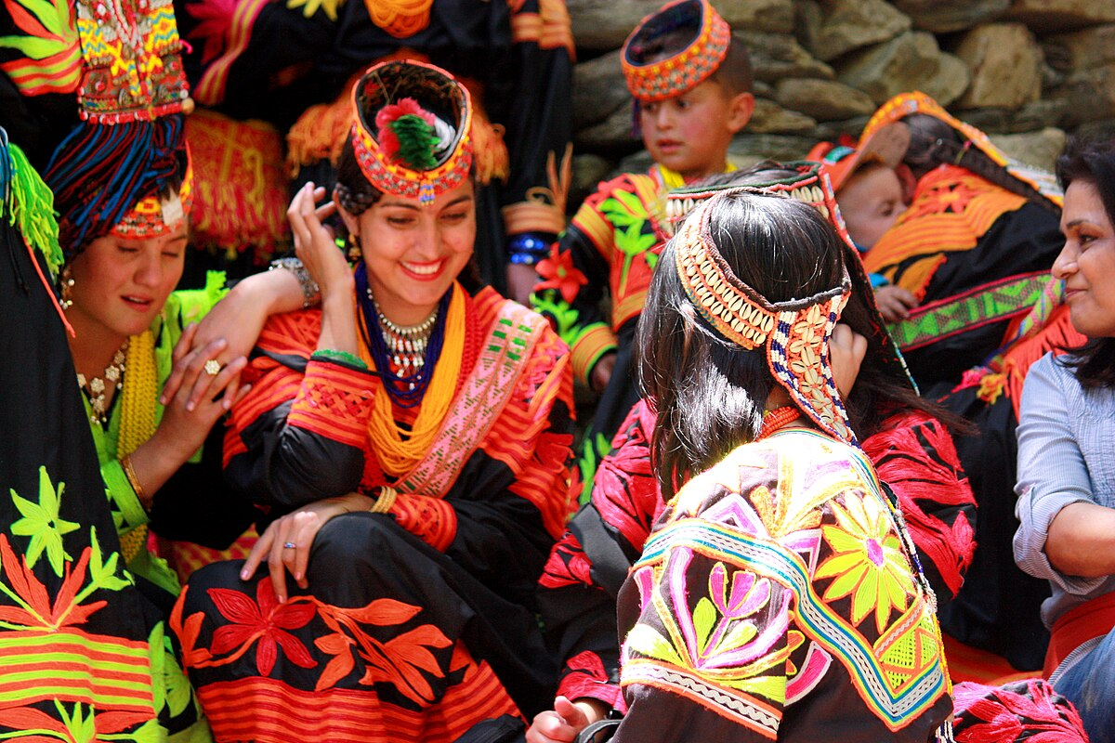
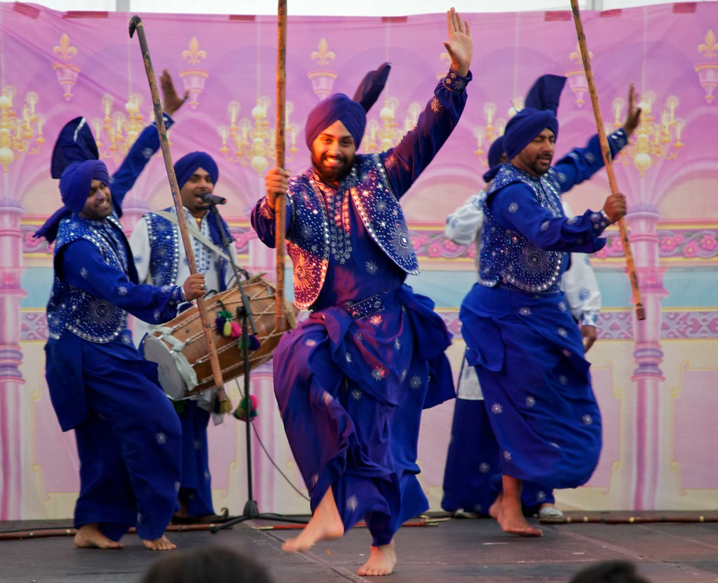
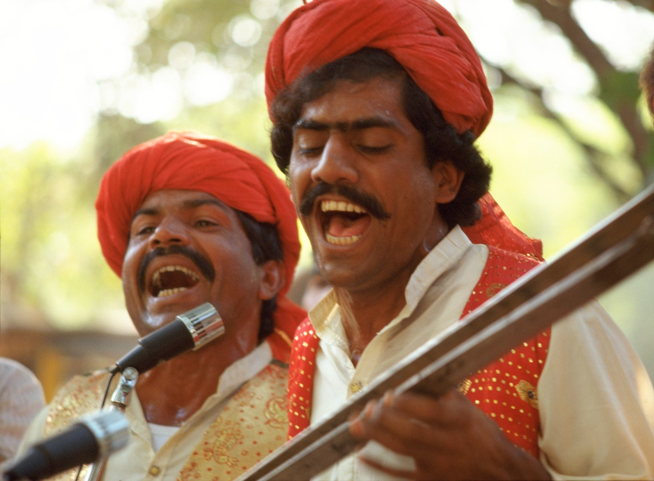
Culture Of Pakistan
This Photo by Unknown Author is licensed under CC BY
This Photo by Unknown Author is licensed under CC BY-NC-ND

Slide 8
National things of Pakistan
Lanuage: Urdu.
Dress: shalwar kameez.
Flower: Jasmine.
Game: Hockey.
Animal: Markhor.
Bird: Chakor.
Currency: Rupees.

Slide 9
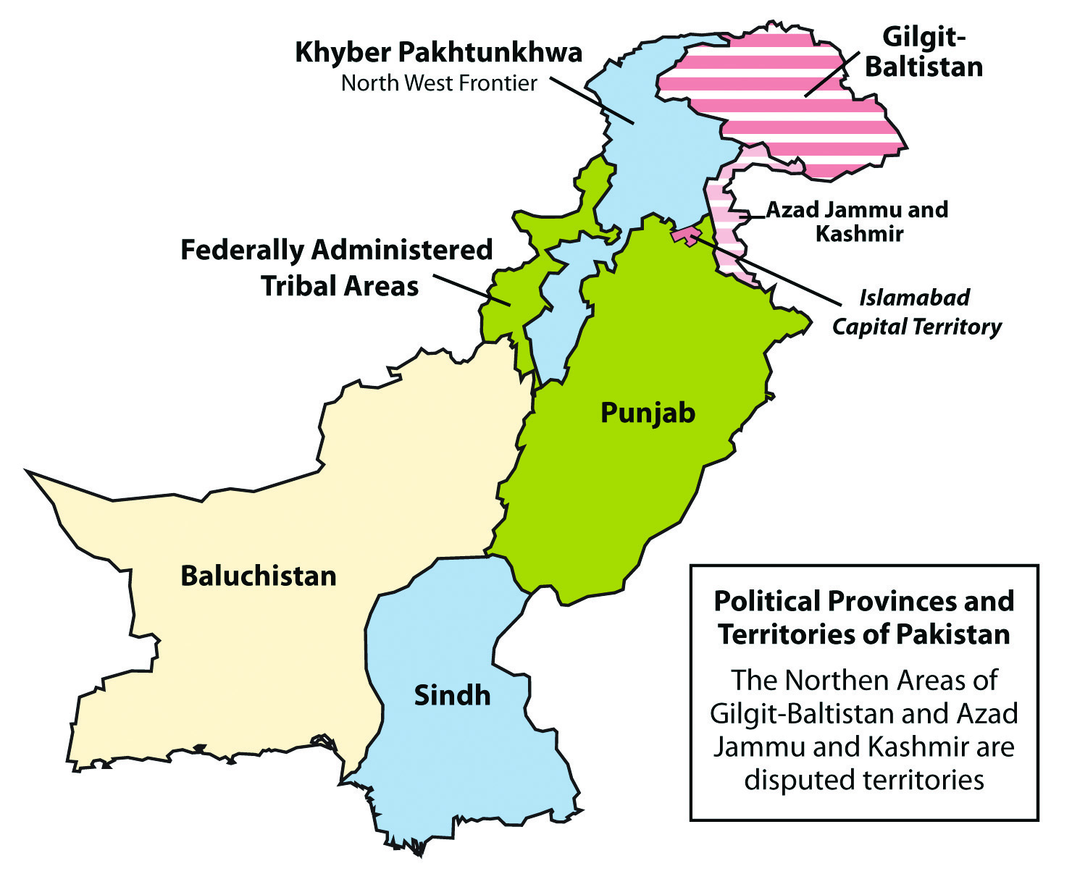
Map of Pakistan

